Slide 1

Attribute Types

Slide 2

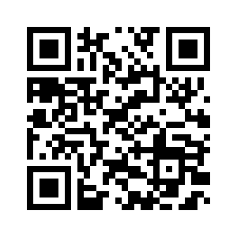
This comic was created in the course of the research project Comixplain, funded by St. Pölten UAS in the course of the Innovation Call 2022.
Project Team:
Victor-Adriel De-Jesus-Oliveira
Hsiang-Yun Wu
Christina Stoiber
Magdalena Boucher
Alena Ertl
Contact:
victor.oliveira@fhstp.ac.at
Illustrations: Magdalena Boucher & Alena Ertl
https://fhstp.github.io/comixplain

Slide 3
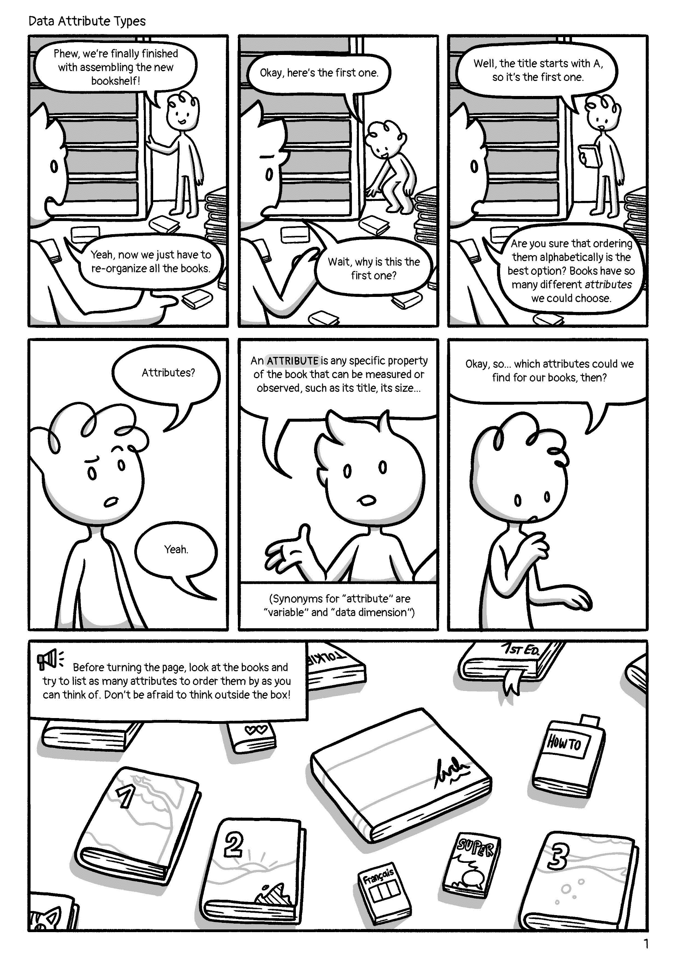

Slide 4
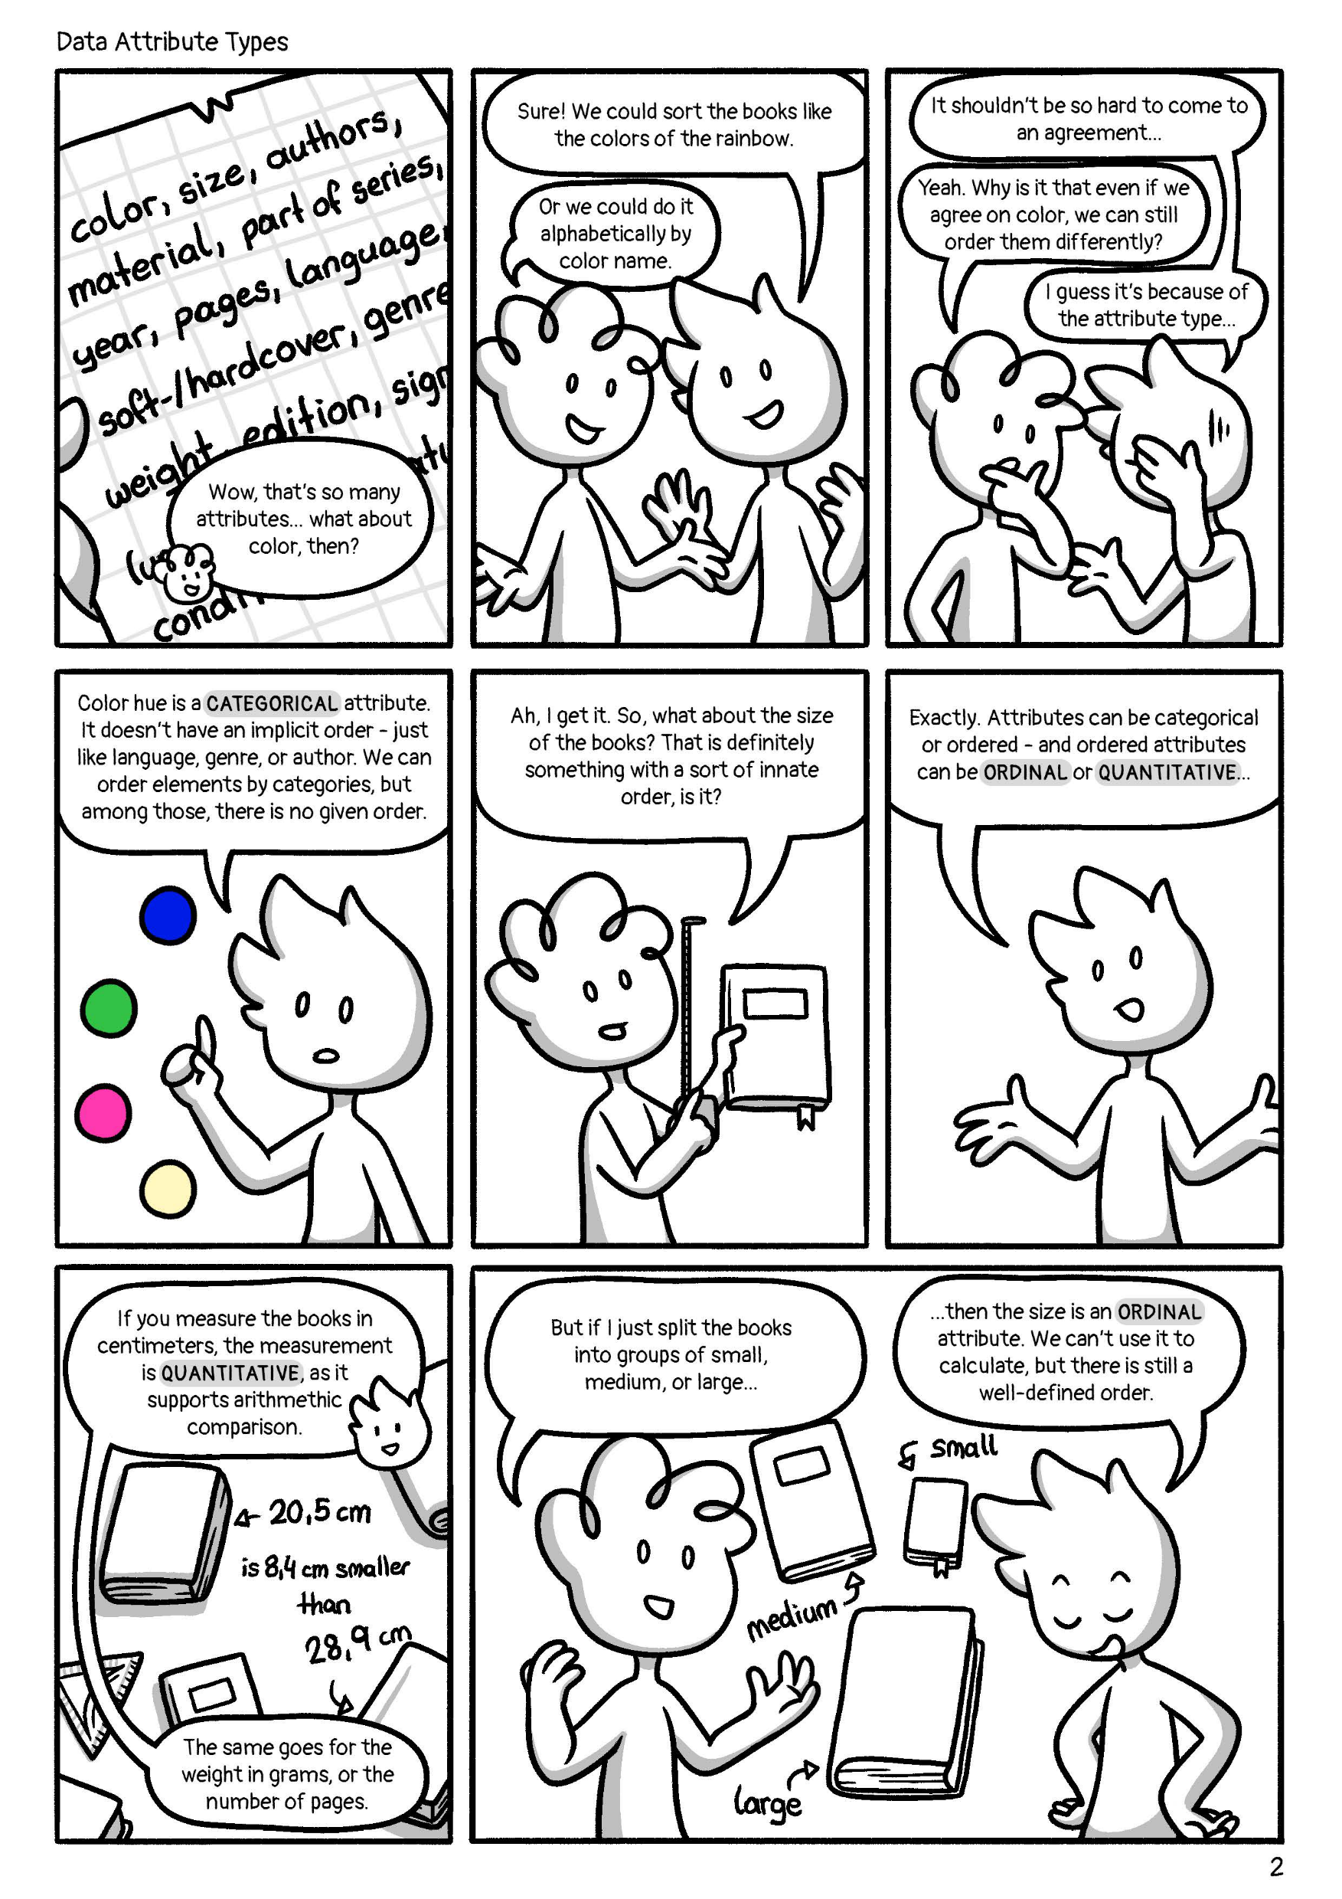

Slide 5
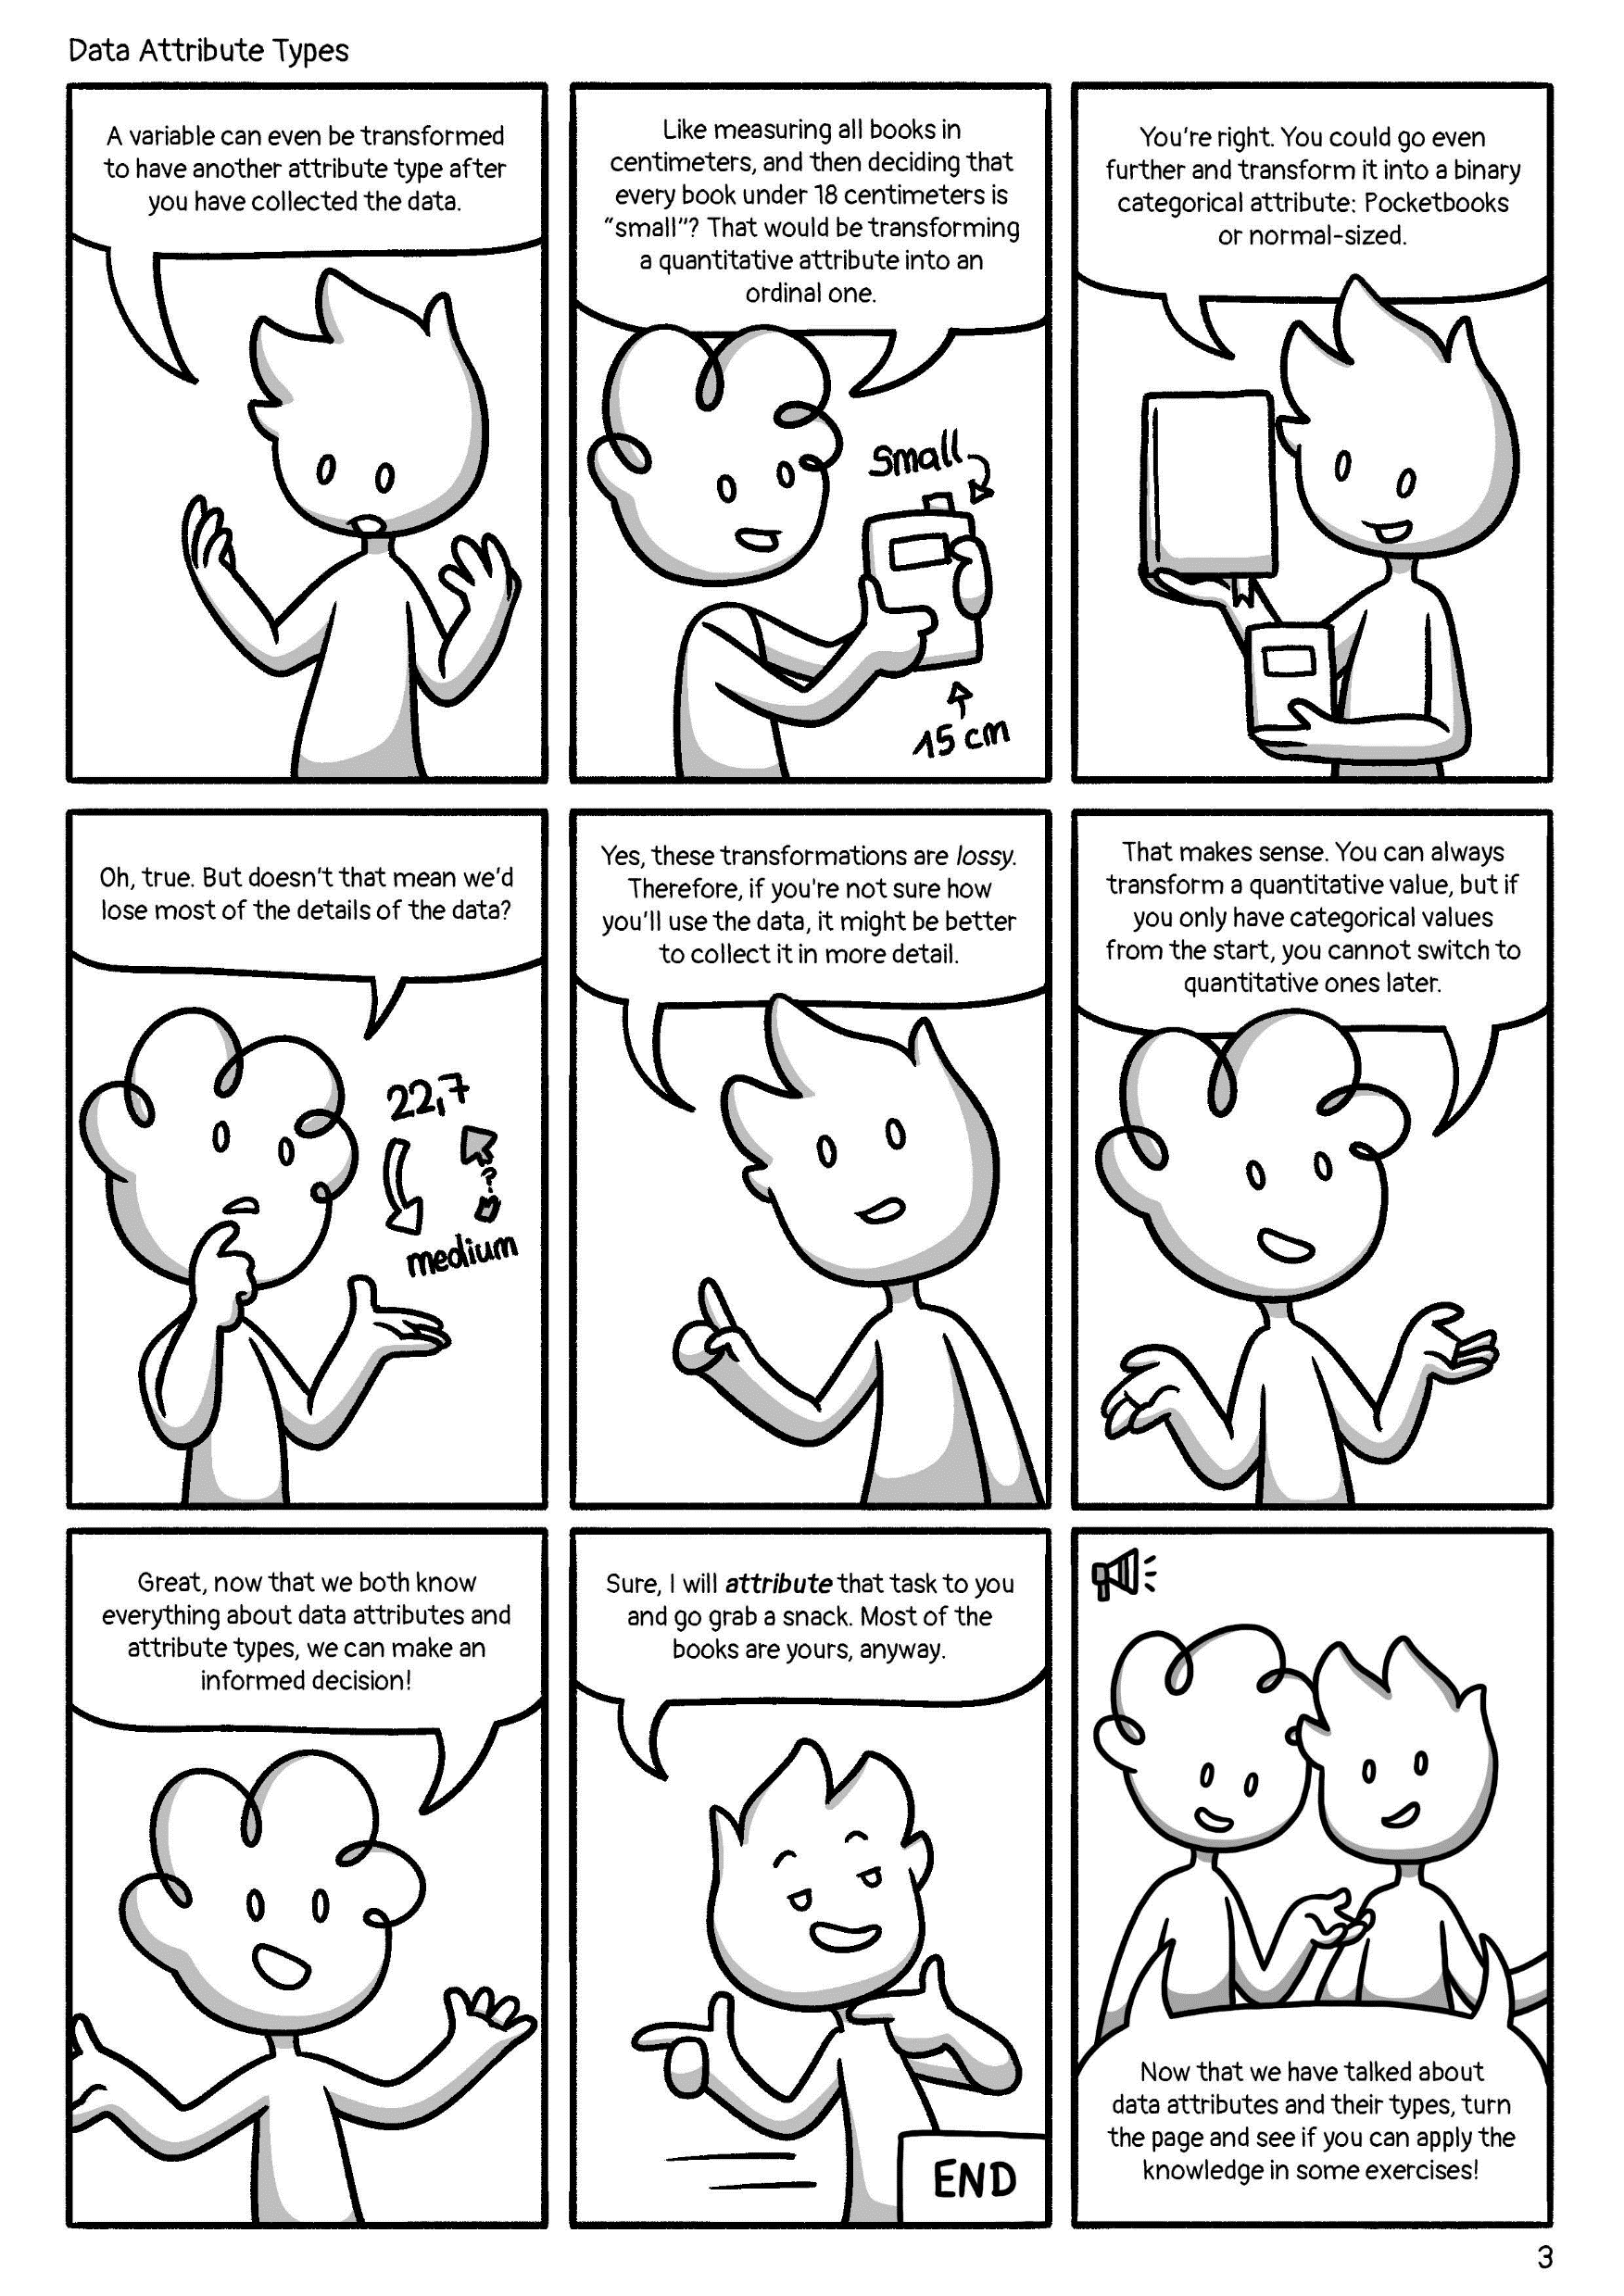

Slide 6
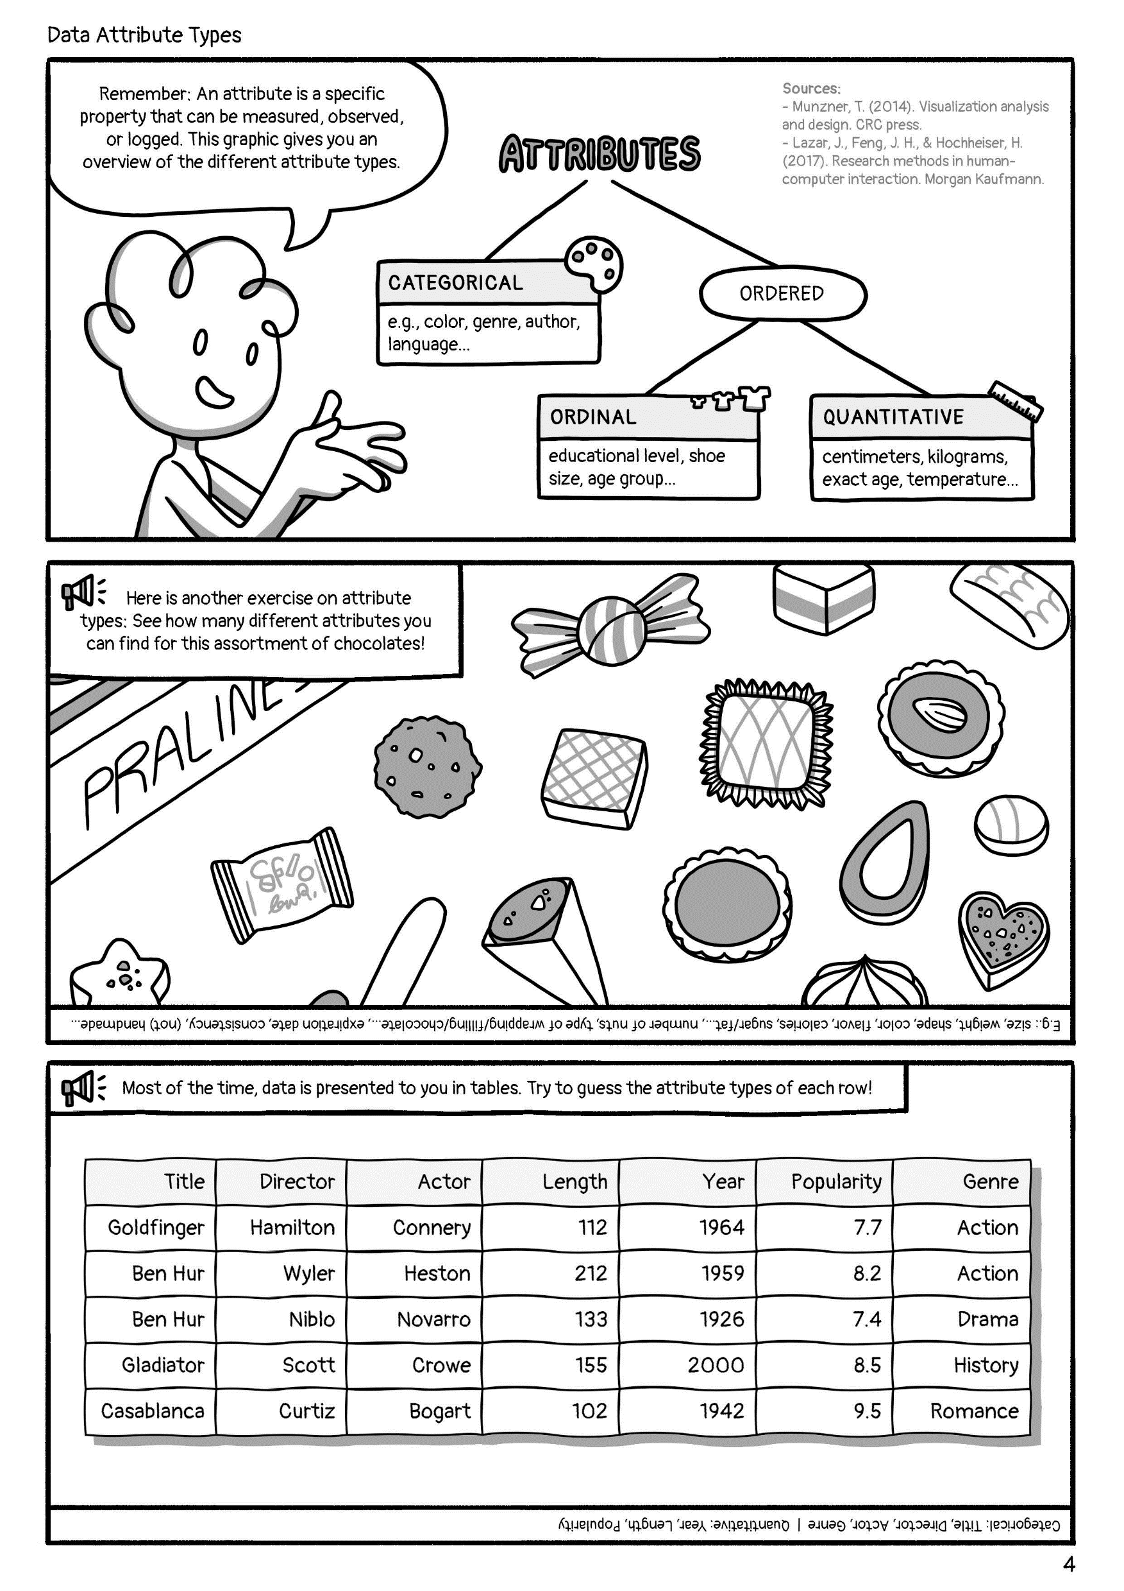

Slide 7
Sources:
Munzner, T. (2014). Visualization analysis and design. CRC press.
Lazar, J., Feng, J. H., & Hochheiser, H. (2017). Research methods in human-computer interaction. Morgan Kaufmann.
Attribute Types © 2022 by Comixplain Team: Victor-Adriel De-Jesus-Oliveira, Hsiang-Yun Wu, Christina Stoiber, Magdalena Boucher, and Alena Ertl, with illustrations by Magdalena Boucher and Alena Ertl, all employed by Sankt Pölten University of Applied Sciences is licensed under CC BY-SA 4.0. To view a copy of this license, visit http://creativecommons.org/licenses/by-sa/4.0/

